Slide 1
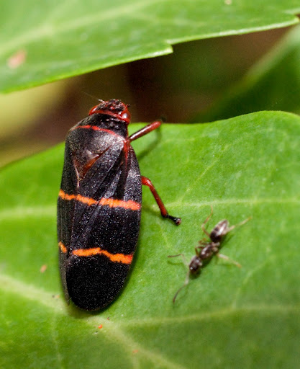
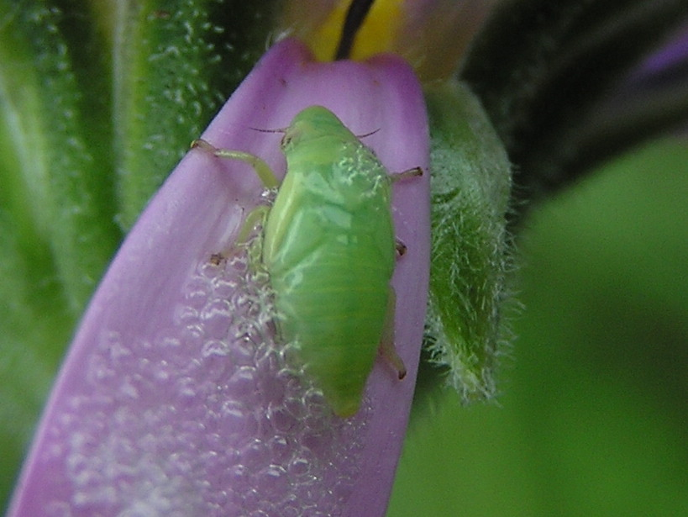
121 Spittlebug
Hemiptera
Hemimetabolous
Piercing-sucking
Pest
Adult
Larvae

Slide 2
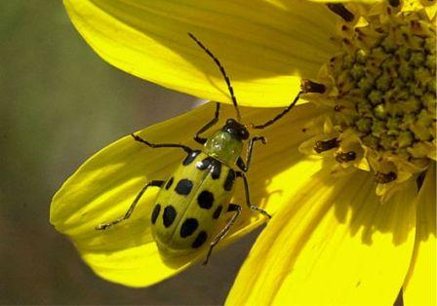
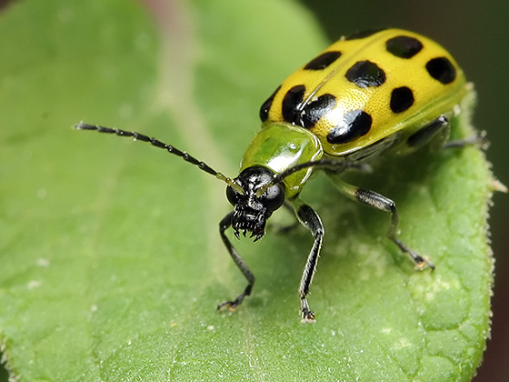
122 Spotted cucumber beetle
Coleoptera
Holometabolous
Chewing
Pest

Slide 3
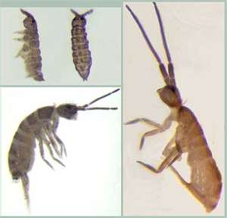
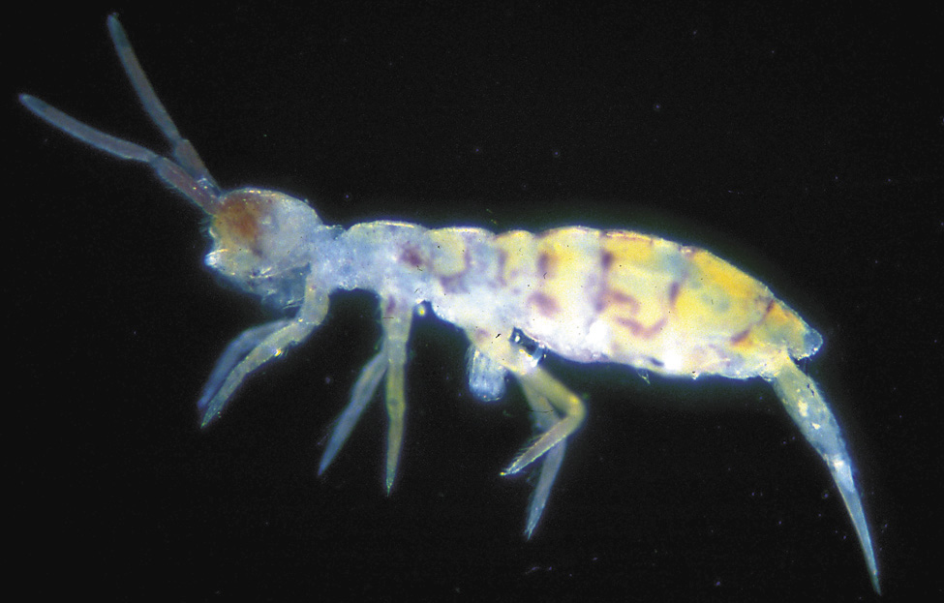
123 Springtail
Collembola
Ametabolous
Chewing
Variable (Pest and Beneficial)
Micrscopic – Notice spike out of abdomen, that is the spring

Slide 4
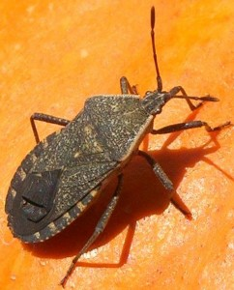
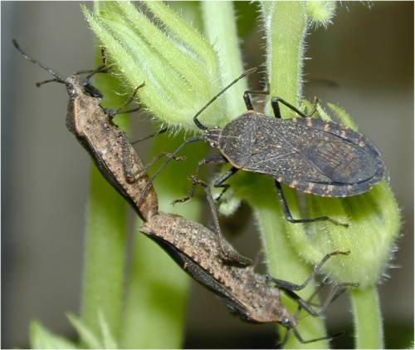
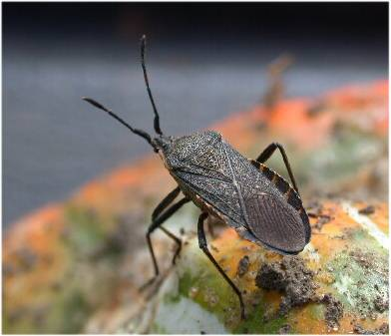
124 Squash bug
Hemiptera
Hemimetabolous
Piercing-sucking
Pest

Slide 5
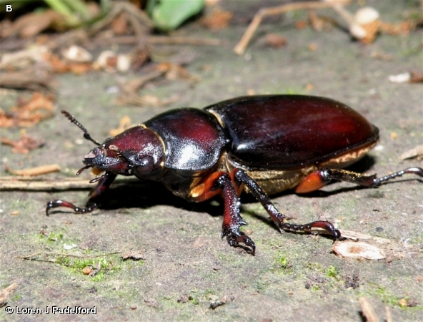
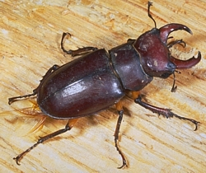
125 Stag beetle
Coleoptera
Holometabolous
Chewing
Variable (Pest and Beneficial)

Slide 6
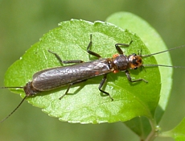
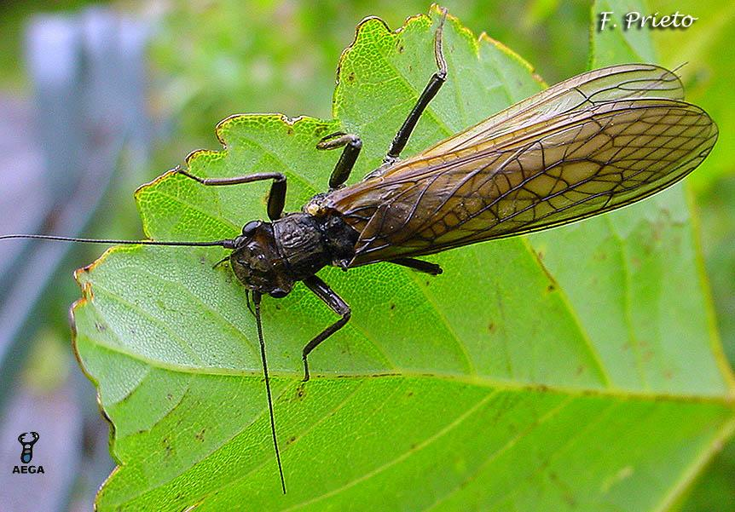
126 Stonefly
Plecoptera
Hemimetabolous
Chewing
Beneficial

Slide 7
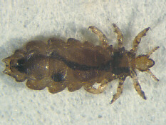
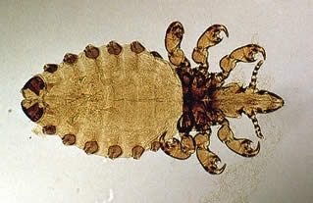
127 Sucking louse
Phthiraptera
Hemimetabolous
Piercing-sucking
Pest

Slide 8
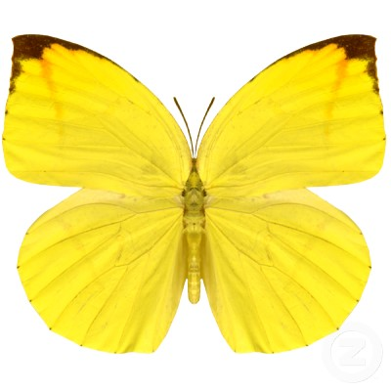
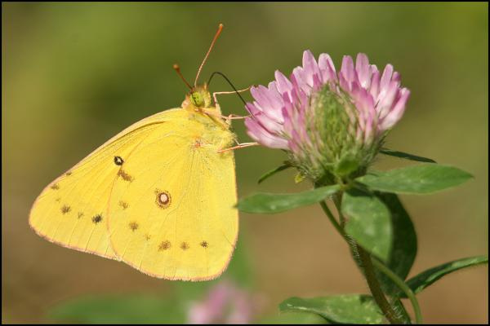
128 Sulphur butterfly
Lepidoptera
Holometabolous
Siphoning
Pest

Slide 9
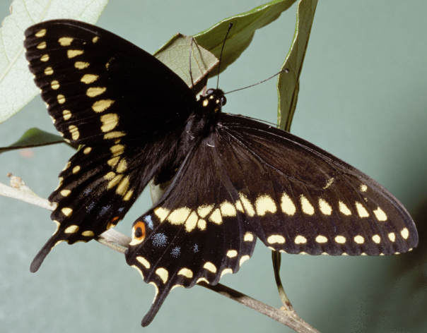
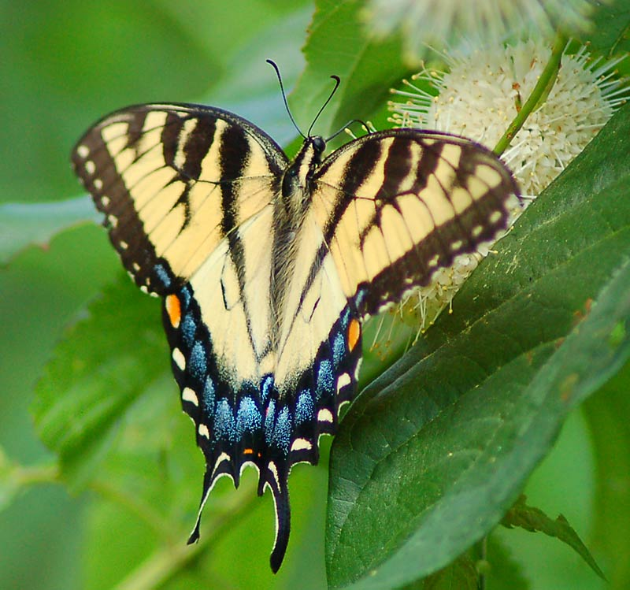
129 Swallowtail butterfly
Lepidoptera
Holometabolous
Siphoning
Beneficial

Slide 10
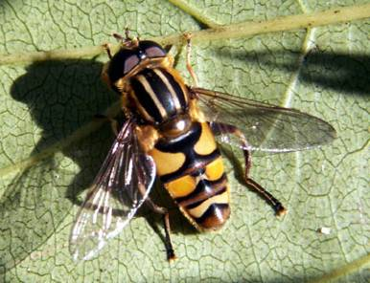
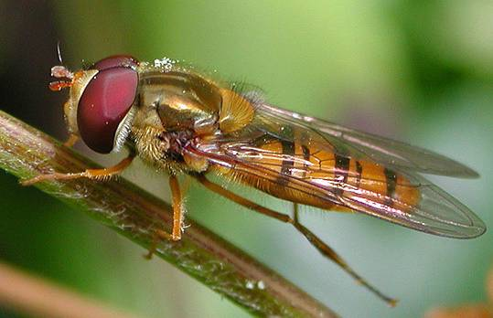
130 Syrphid fly
Looks like a bee with only 2 wings
Diptera
Holometabolous
Sponging
Variable (Beneficial and Pest)

Slide 11
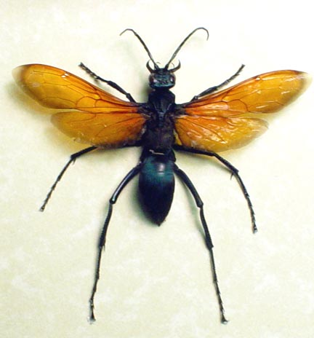
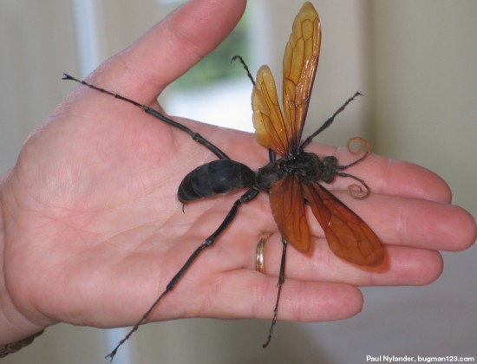
131 Tarantula hawk
Hymenoptera
Holometabolous
Chewing
Variable (Pest and Beneficial)

Slide 12
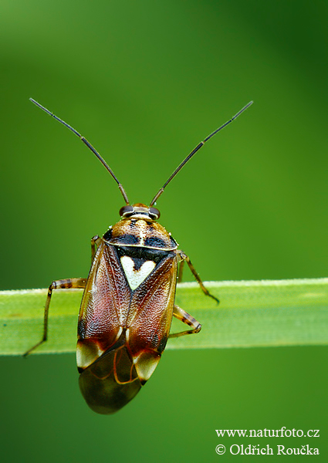
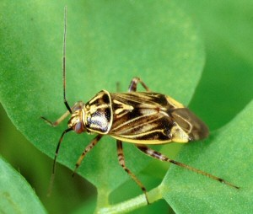
132 Tarnished plant bug
Hemiptera
Hemimetabolous
Piercing-sucking
Pest

Slide 13
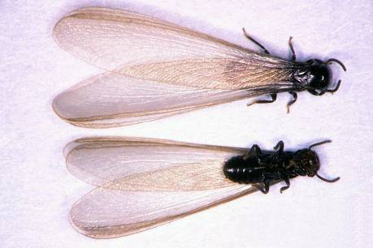
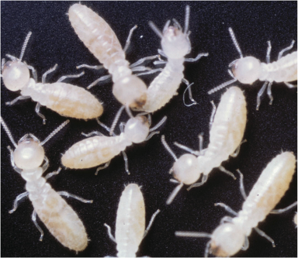
133 Termite
Isoptera
Hemimetabolous
Chewing
Variable

Slide 14
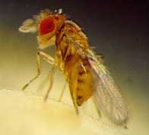
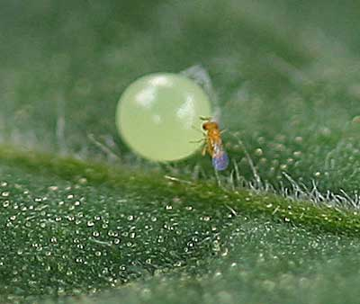
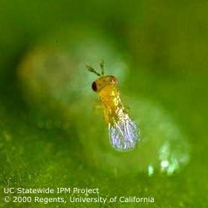
134 Trichogramma wasp
Hymenoptera
Holometabolous
Chewing
Beneficial

Slide 15
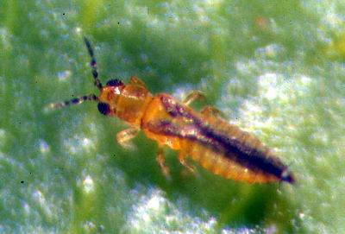
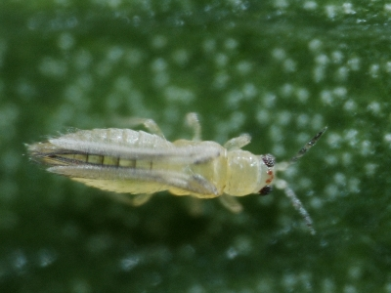
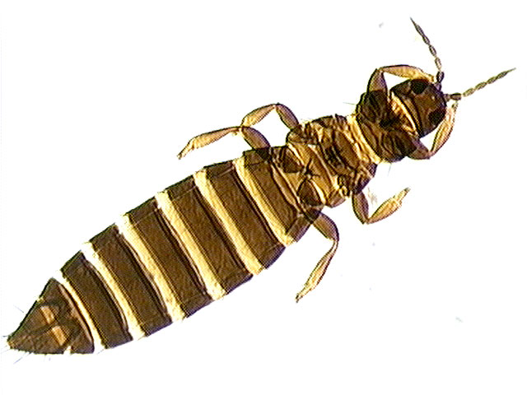
135 Thrips
Thysanoptera
Hemimetabolous
Piercing-sucking
Variable
Microscopic

Slide 16
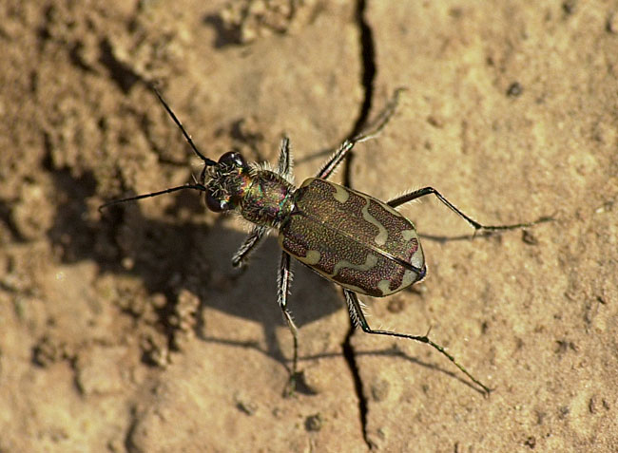
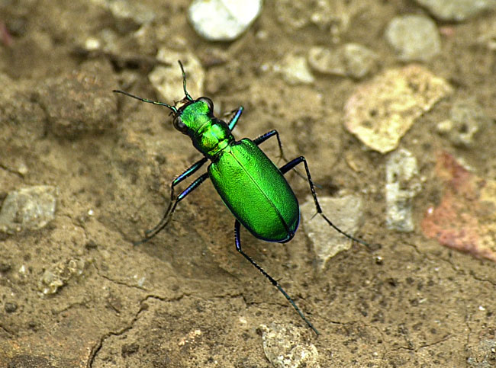
136 Tiger beetle
Coleoptera
Holometabolous
Chewing
Beneficial

Slide 17
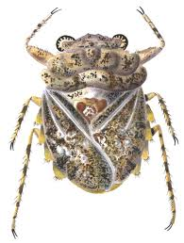
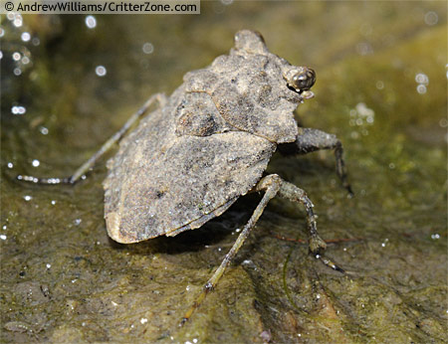
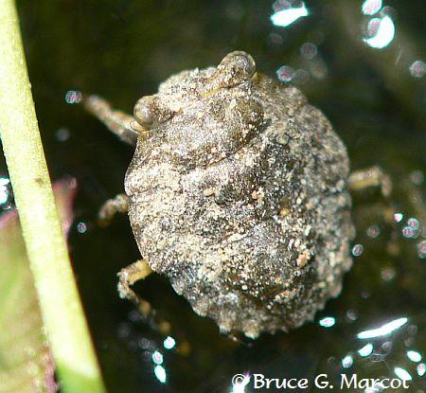
137 Toad bug
Hemiptera
Hemimetabolous
Piercing-sucking
Beneficial

Slide 18
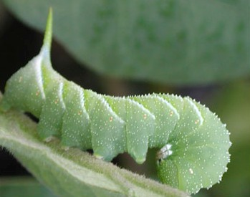
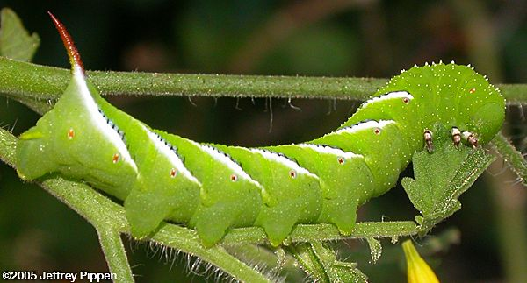
138 Tomato hornworm
Lepidoptera
Holometabolous
Chewing
Pest
Notice the horn – will be in glass vial

Slide 19
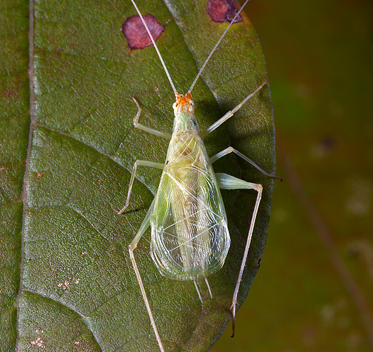
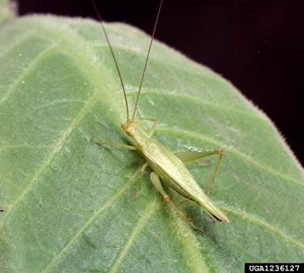
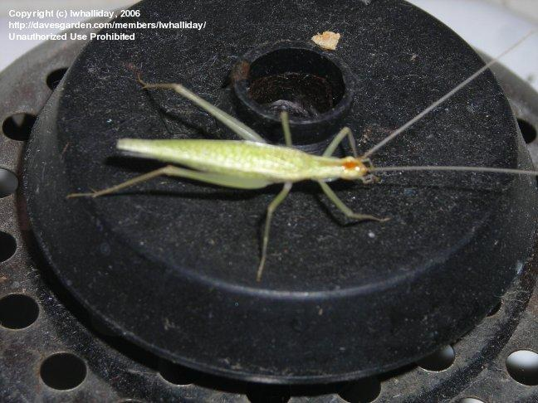
139 Tree cricket
Orthoptera
Hemimetablolous
Chewing
Variable

Slide 20
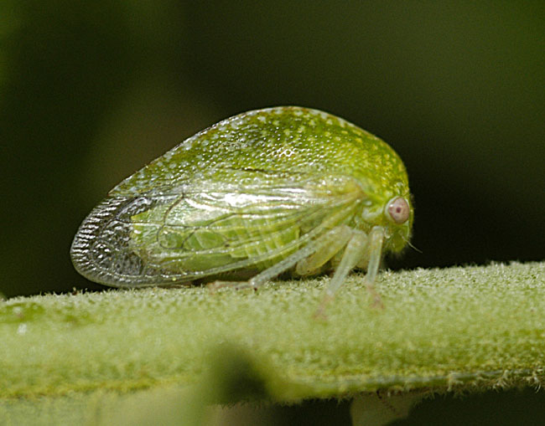
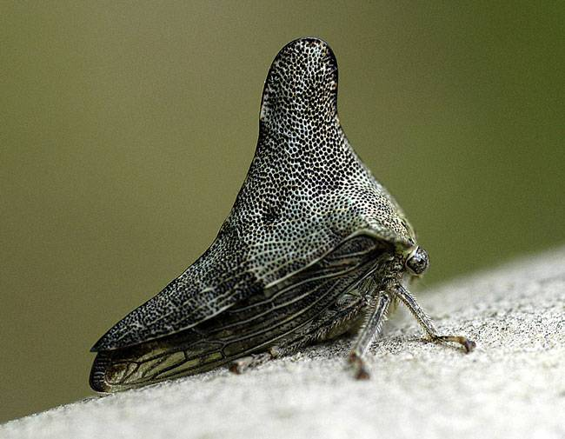
140 Treehopper
Hemiptera
Hemimetabolous
Piercing-sucking
Pest

Slide 21
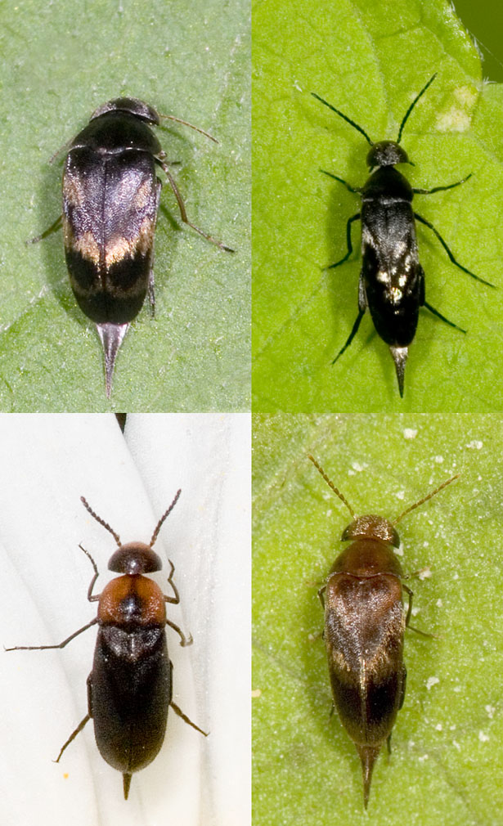
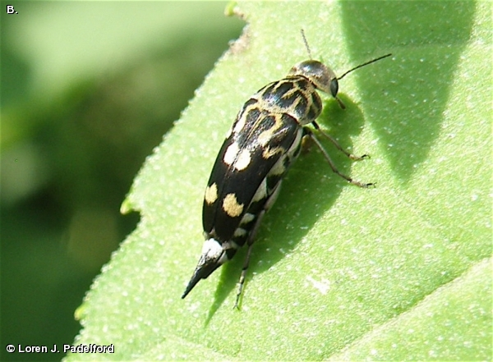
141 Tumbling flower beetle
Coleoptera
Holometabolous
Chewing
Variable
Notice Tail

Slide 22
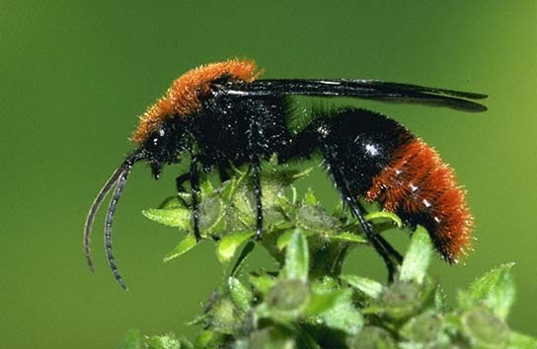
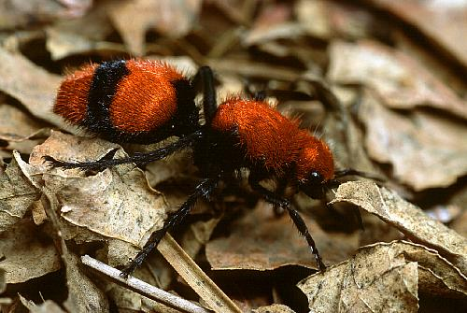
142 Velvet ant
Hymenoptera
Holometabolous
Chewing
Variable

Slide 23
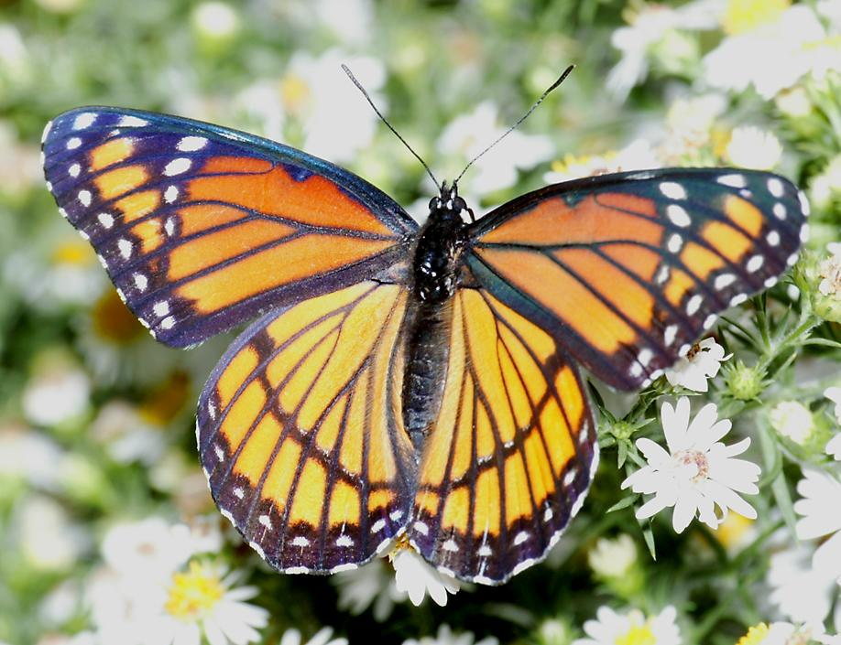
143 Viceroy butterfly
Lepidoptera
Holometabolous
Siphoning
Beneficial
Similar to Monarch but this horizontal line is not in Monarch

Slide 24
144 Vinegaroon
Non-insect
Chewing
Variable

Slide 25
145 Walkingstick
Phasmatodea
Hemimetabolous
Chewing
Variable

Slide 26
146 Water boatman
Hemiptera
hemimetabolous
Piercing-sucking
Beneficial

Slide 27
147 Water strider
Hemiptera
Hemimetabolous
Piercing-sucking
Beneficial

Slide 28
148 Whirligig beetle
Coleoptera
Holometabolous
Chewing
Beneficial

Slide 29
149 White grub
Coleoptera
Holometabolous
Chewing
Pest

Slide 30
150 Whitefly
Hemiptera
Hemimetabolous
Piercing-sucking
Pest
IN A GLASS VIAL

